Slide 1
Turbulent Flow Simulation on HPC Final Presentation
Marten Lienen, Peter Münch, Walter Simson, Josef Winter
Notes:
Introduce the team
WHAT AND WHY
-KE model
-Binary file out
-decompisition algo
-instrumentation

Slide 2
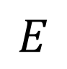
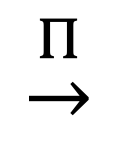
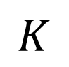
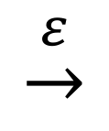

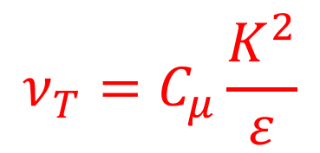

Basics of the k-ɛ Turbulence Model
$$\underline{u}(x_{i},t)=\left\langle \underline{u}\right\rangle (x_{i})+\underline{u}′(x_{i},t)$$
laminar basic flow
fluctuation flowfield
$$ν_{T}=C_{μ}\frac{K^{2}}{ε}$$
$$\underset{→}{Π}$$
$$\underset{→}{ε}$$
$$E$$
$$K$$
$$U$$
k-ɛ turbulence model
Kolmogorov theory

Slide 3
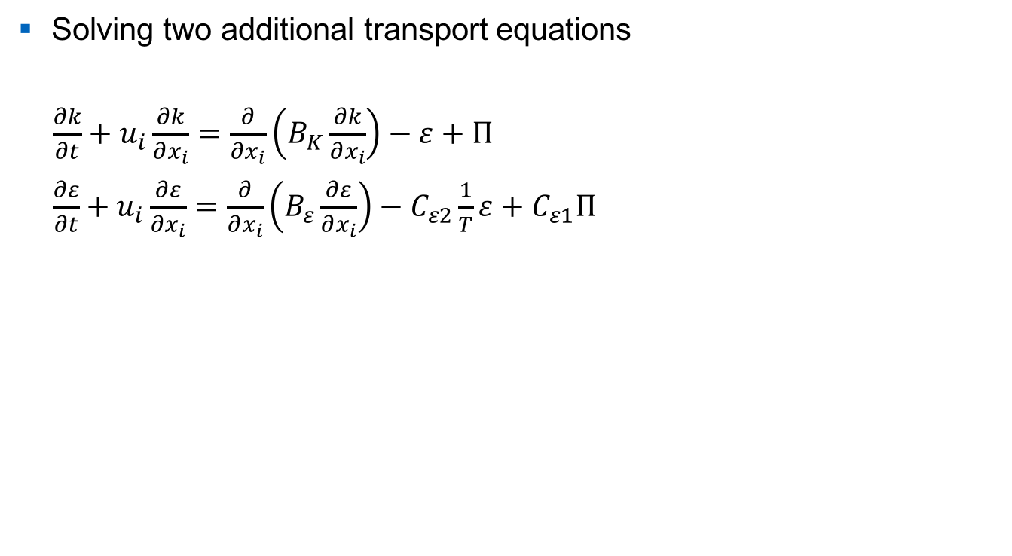
Requirements of the k-ɛ Turbulence Model
Solving two additional transport equations
$\frac{∂k}{∂t}+u_{i}\frac{∂k}{∂x_{i}}=\frac{∂}{∂x_{i}}\left(B_{K}\frac{∂k}{∂x_{i}}\right)−ε+Π$
$\frac{∂ε}{∂t}+u_{i}\frac{∂ε}{∂x_{i}}=\frac{∂}{∂x_{i}}\left(B_{ε}\frac{∂ε}{∂x_{i}}\right)−C_{ε2}\frac{1}{T}ε+C_{ε1}Π$
Improvements in velocity profile?
Where is K produced and where dissipated?

Slide 4
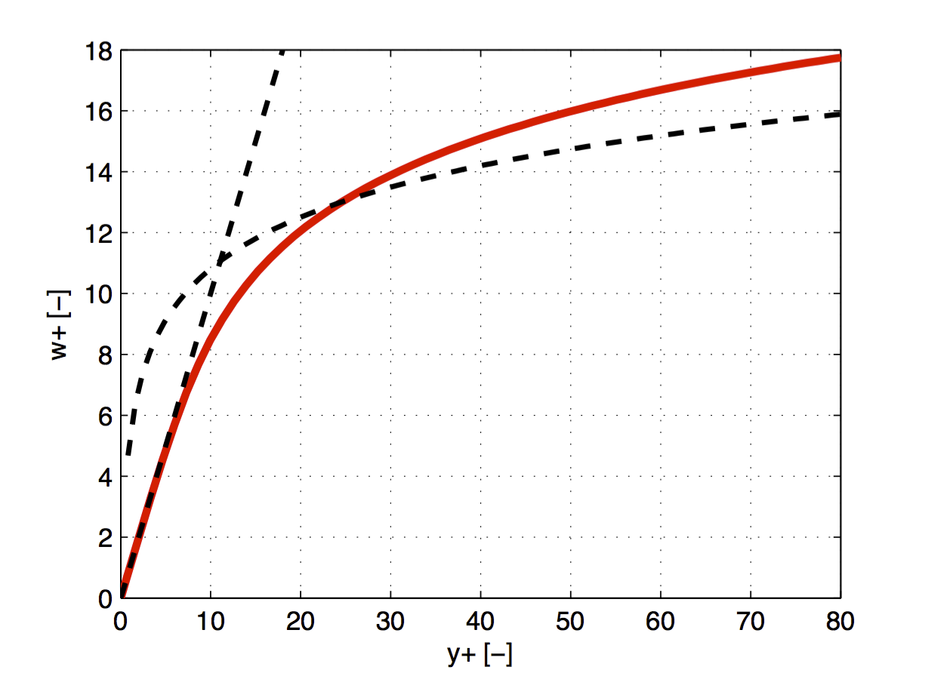
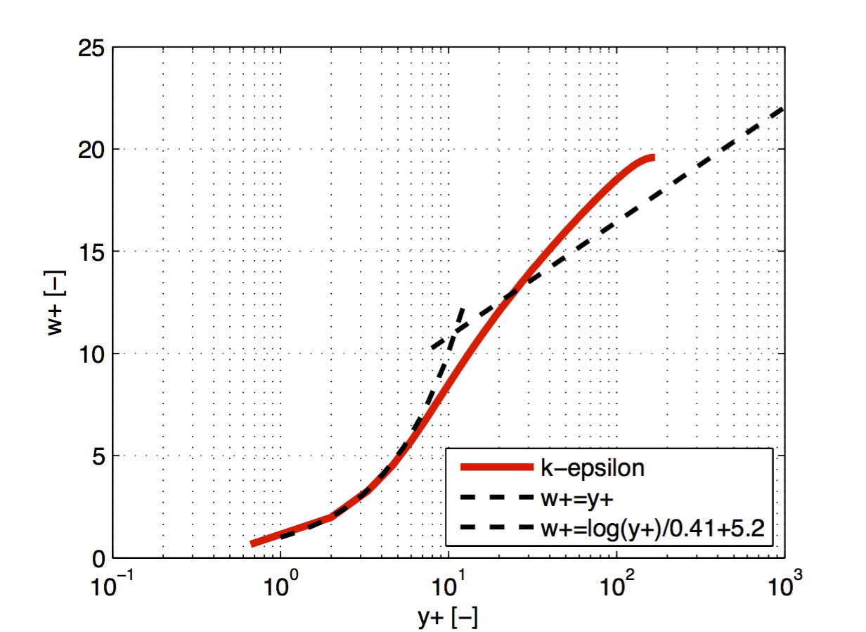
Validation – Velocity Profiles
Re = 5600
Linear Scale
Half-Logarithmic Scale

Slide 5
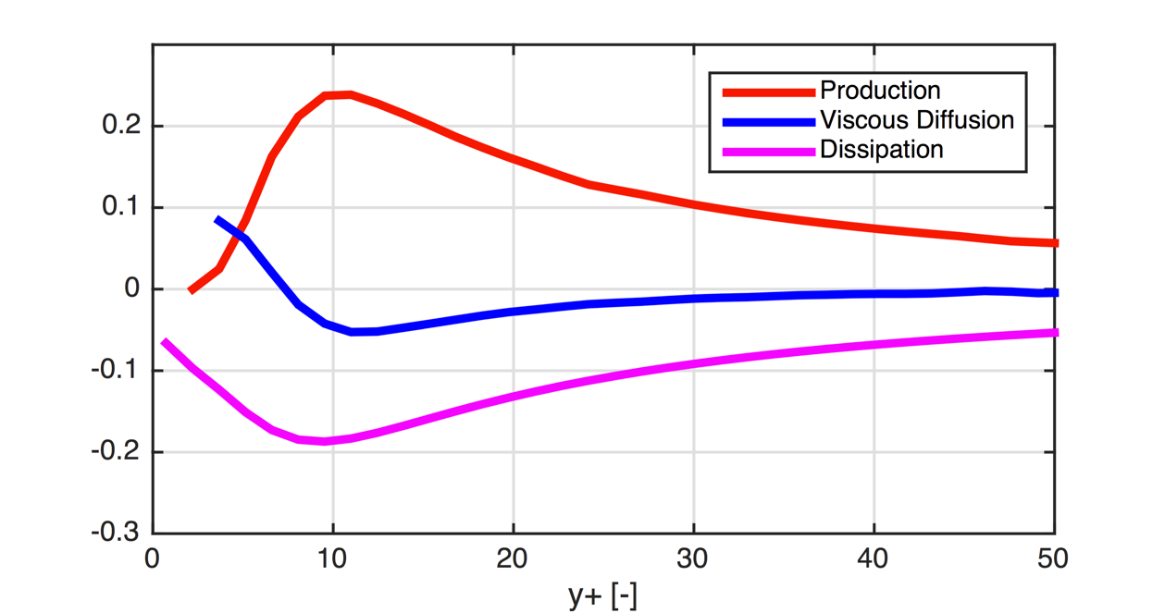
Gain and Loss of Turbulent Kinetic Energy
Re = 13750
Gain [-]
Loss [-]

Slide 6
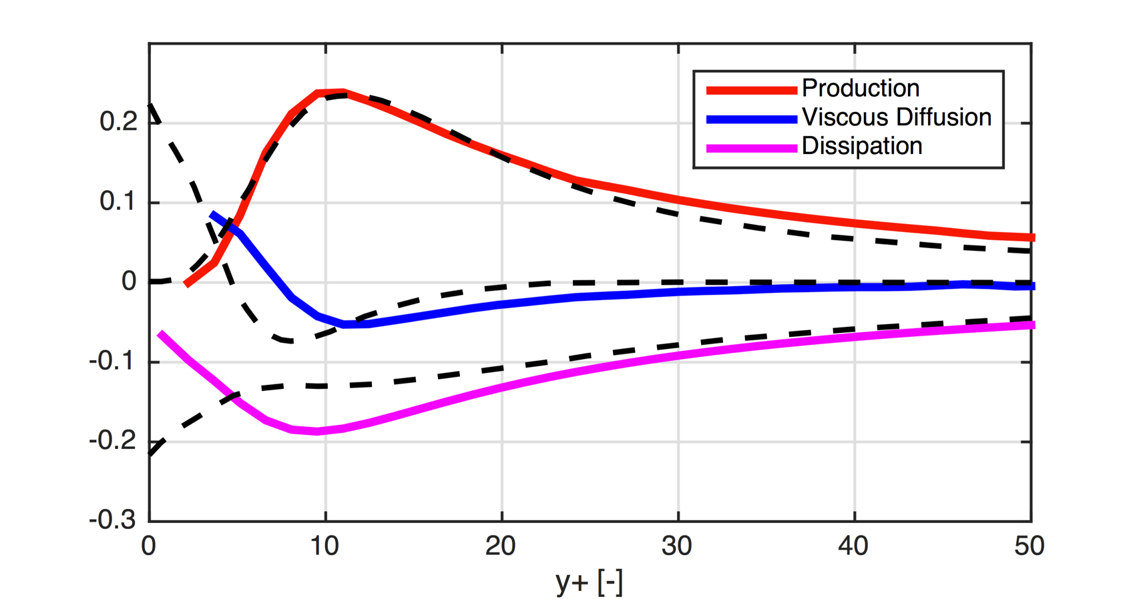
Gain and Loss of Turbulent Kinetic Energy
Re = 13750
Gain [-]
Loss [-]
Pope (2000)

Slide 7
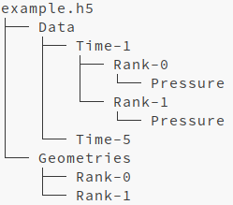

Binary Data Output with HDF5

Slide 8
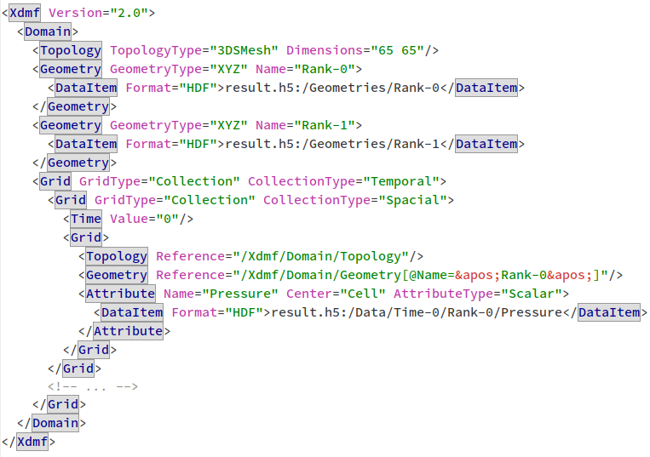
Binary Data Output with HDF5 and XDMF

Slide 9
PETSc-Optimization

Slide 10
PETSc-Optimization
Laminar
Turbulent

Slide 11

Decomposition
Decomposing a 5 x 1 domain into n = 60 subdomains
Prime factorization of n is $\left\{2, 2, 3, 5\right\}$

Slide 12
Instrumentation
Process of modifying programs to detect and report events
Manual Instrumentation
Large effort, error prone
Difficult to manage
Automatic instrumentation
With compiler wrapper
…
Intrumentation with ScoreP isualisation with Vampir

Slide 13
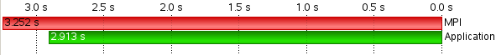
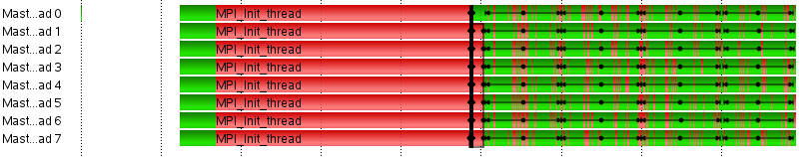
ScoreP

Slide 14
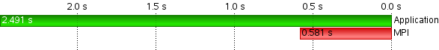
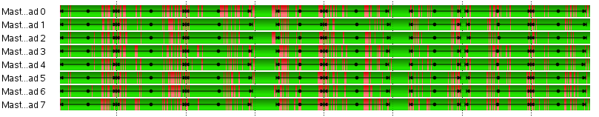
ScoreP

Slide 15
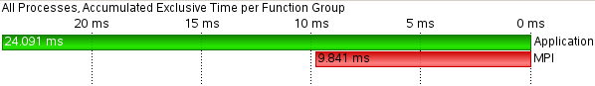
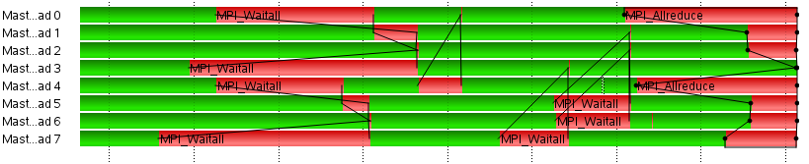
ScoreP

Slide 16
Conclusion
Successful implementation of the k-ɛ turbulence model (error for channel simulation <10%)
PETSc can be optimized (up to one order of magnitude more efficient that the default configuration)
Binary ParaView output with HDF5 could be extended to serve as checkpoint

Slide 17

Karman Vortex Street

